Slide 1
INVESTMENT CASE STUDY SUBMISSION
Shashi Bhushan

Slide 2
Top Companies by Sector and Country to Invest in
Only Venture Fund Type suits Spark Funds constraint of 5 to 15 million USD investments.
Top English Speaking countries for Spark Funds to invest in are USA, Great Britain and India.
Top Sectors to invest in individual countries will be presented in next slides.

Slide 3
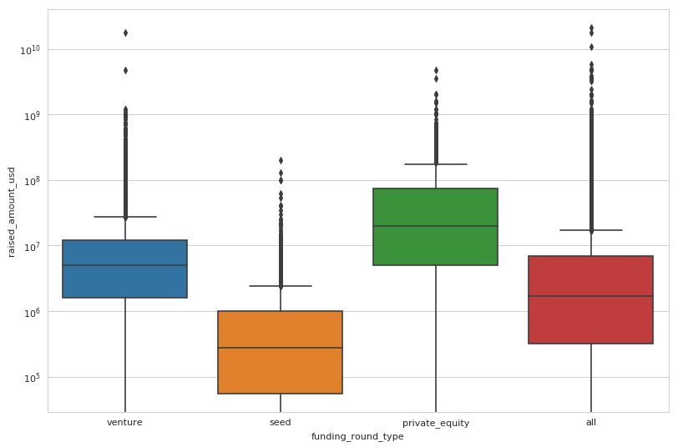
Raised Amount in Funding across Different Funding Types
Venture is the preferred Fund type as it falls between 5 to 15 million USD range.

Slide 4
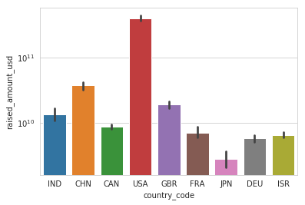
Raised Amount in funding across Top 9 Countries
USA is on top followed by GBR and IND. CHN is excluded being non english speaking country.

Slide 5
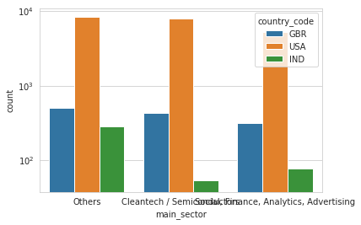
Raised Amount in Top 3 Countries across Top 3 Sections

Slide 6
Results
Only Venture Fund Type suits Spark Funds constraint of 5 to 15 million USD investments.
Top English Speaking countries for Spark Funds to invest in are USA, Great Britain and India.

